Slide 1
Chiba campaign 2019
Yamaguchi Kodai
11月29日更新
DN=333

Slide 2
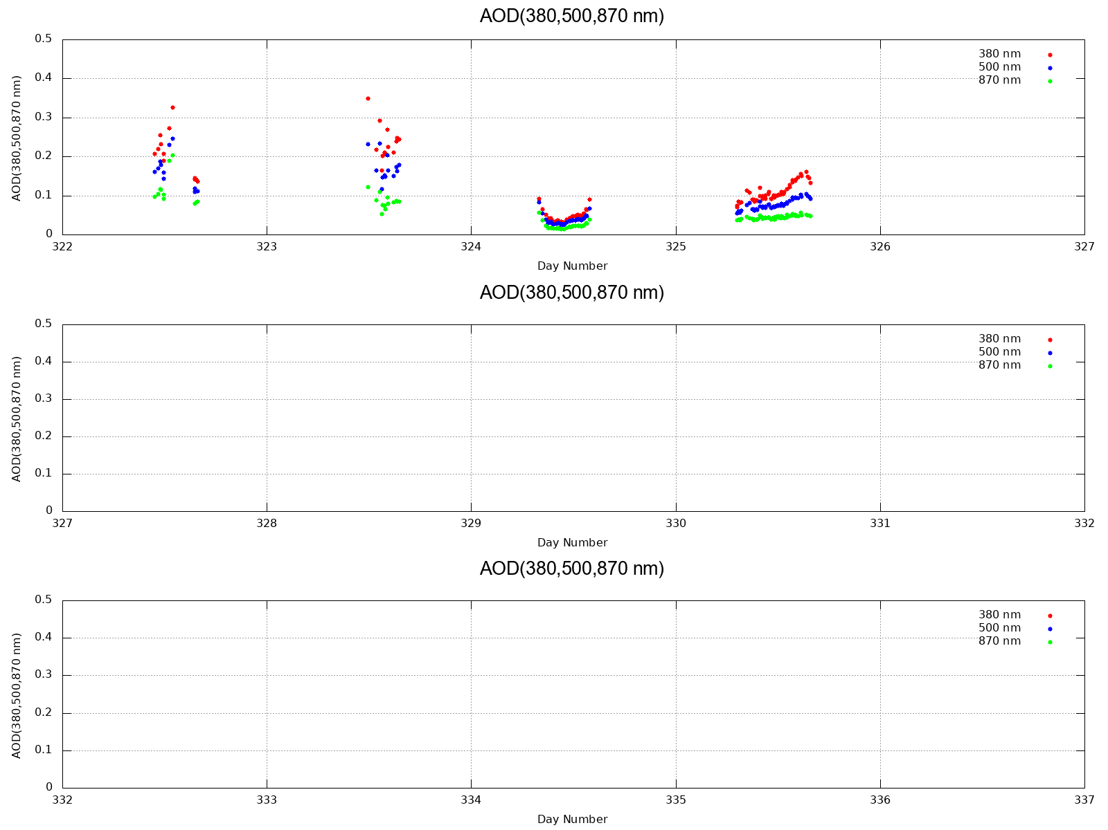
AOD (380,500,870 nm)

Slide 3
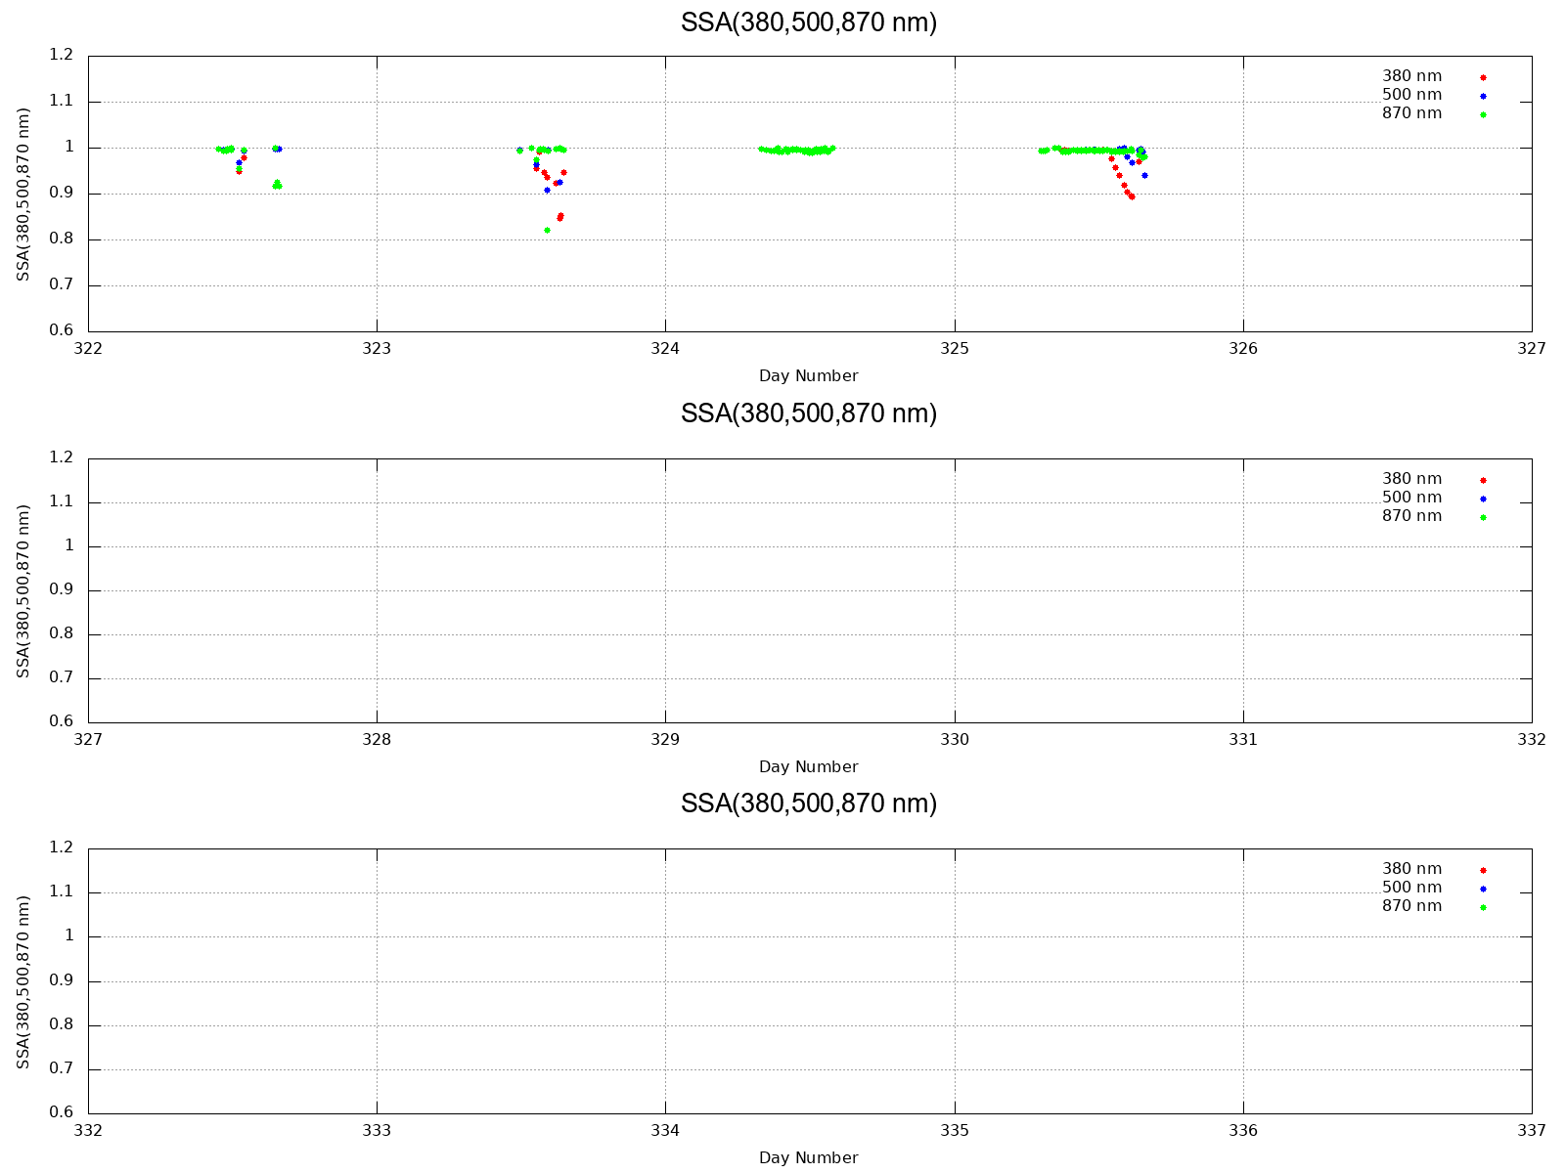
SSA (380,500,870 nm)

Slide 4
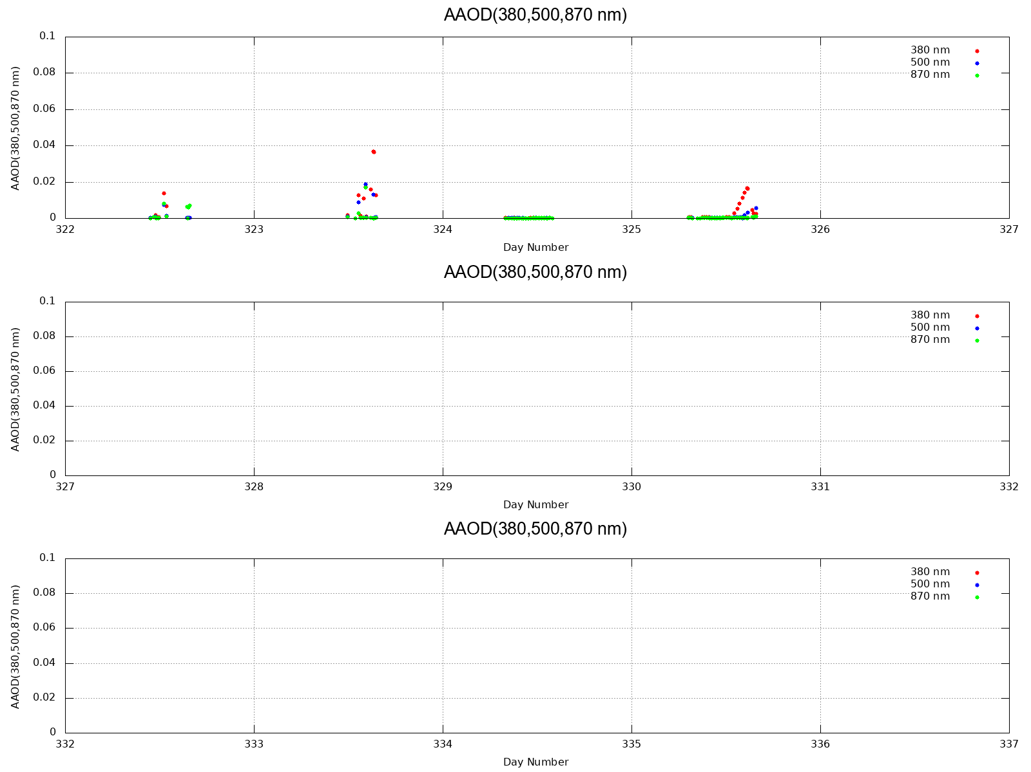
AAOD (380,500,870 nm)

Slide 5
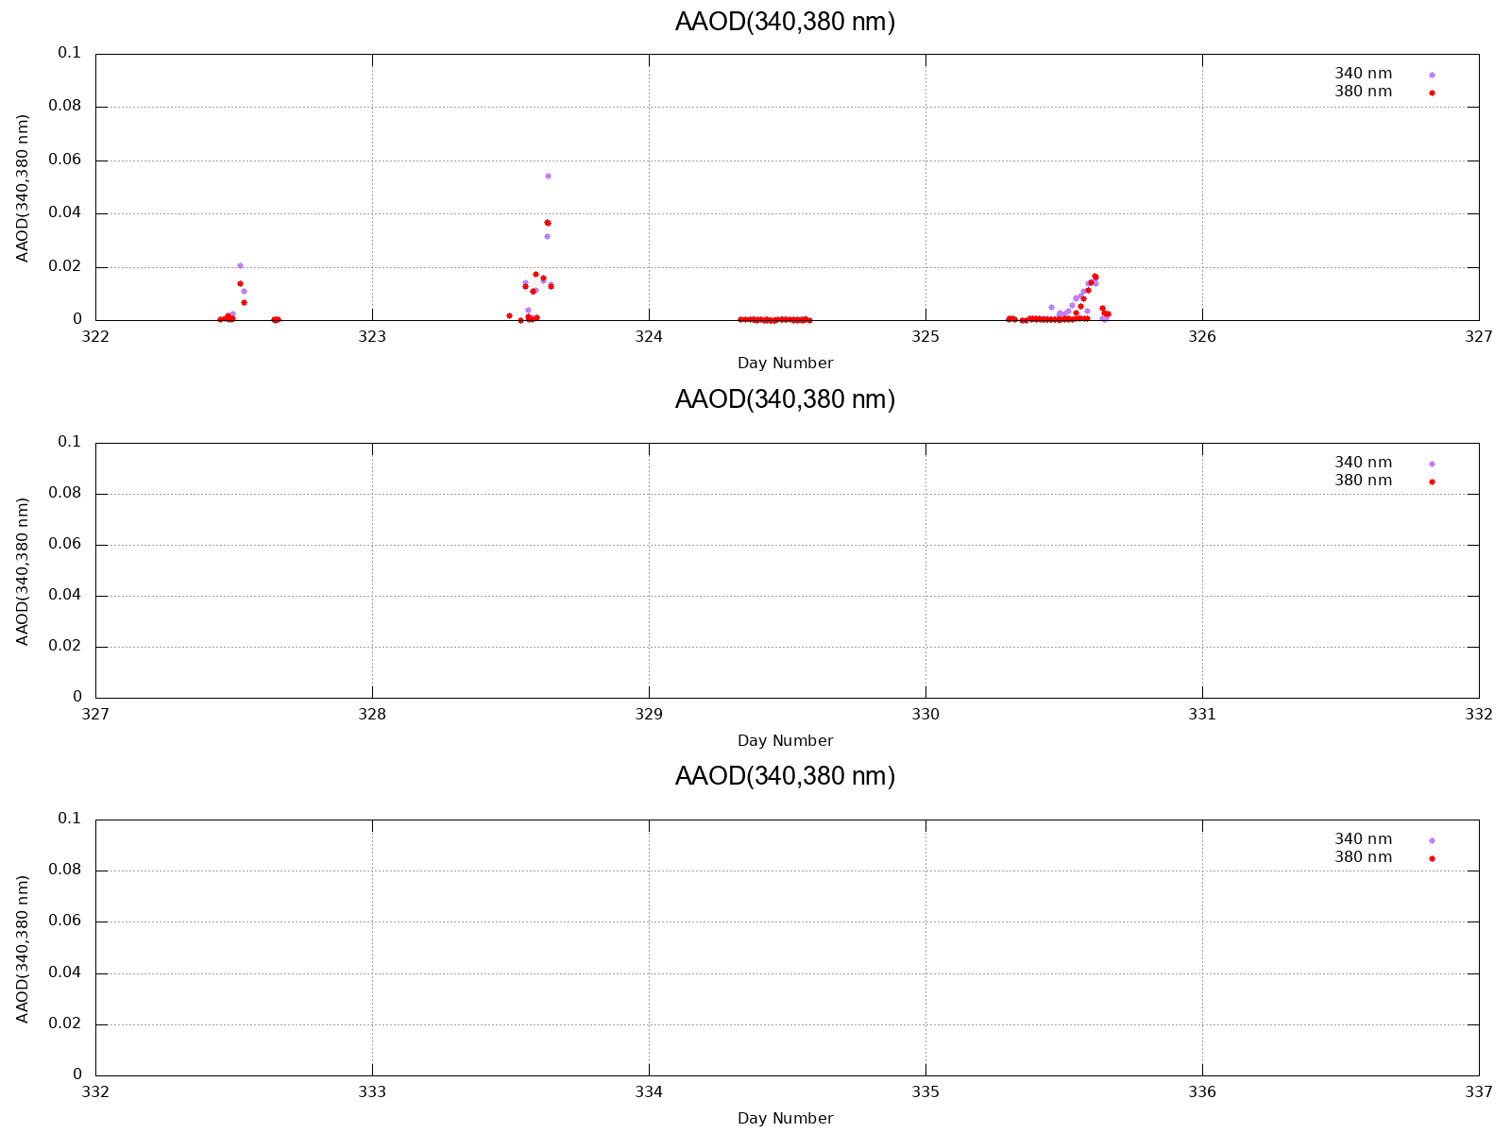
AAOD (340,380 nm)

Slide 6
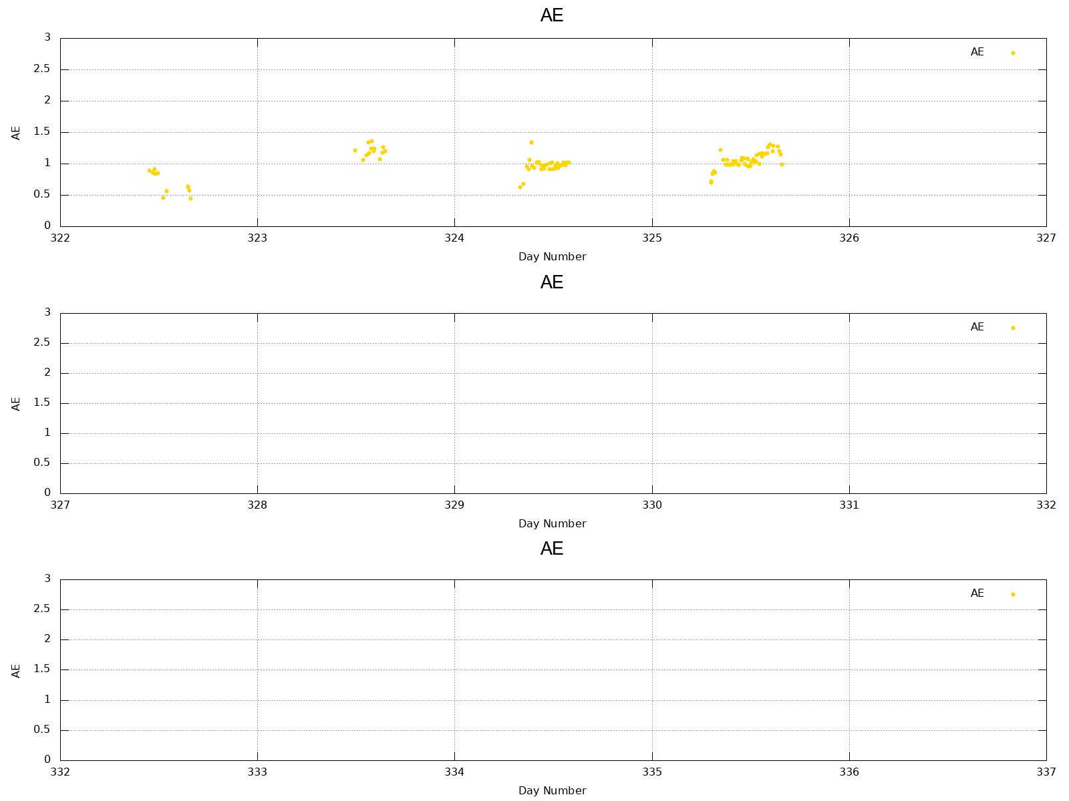
AE

Slide 7
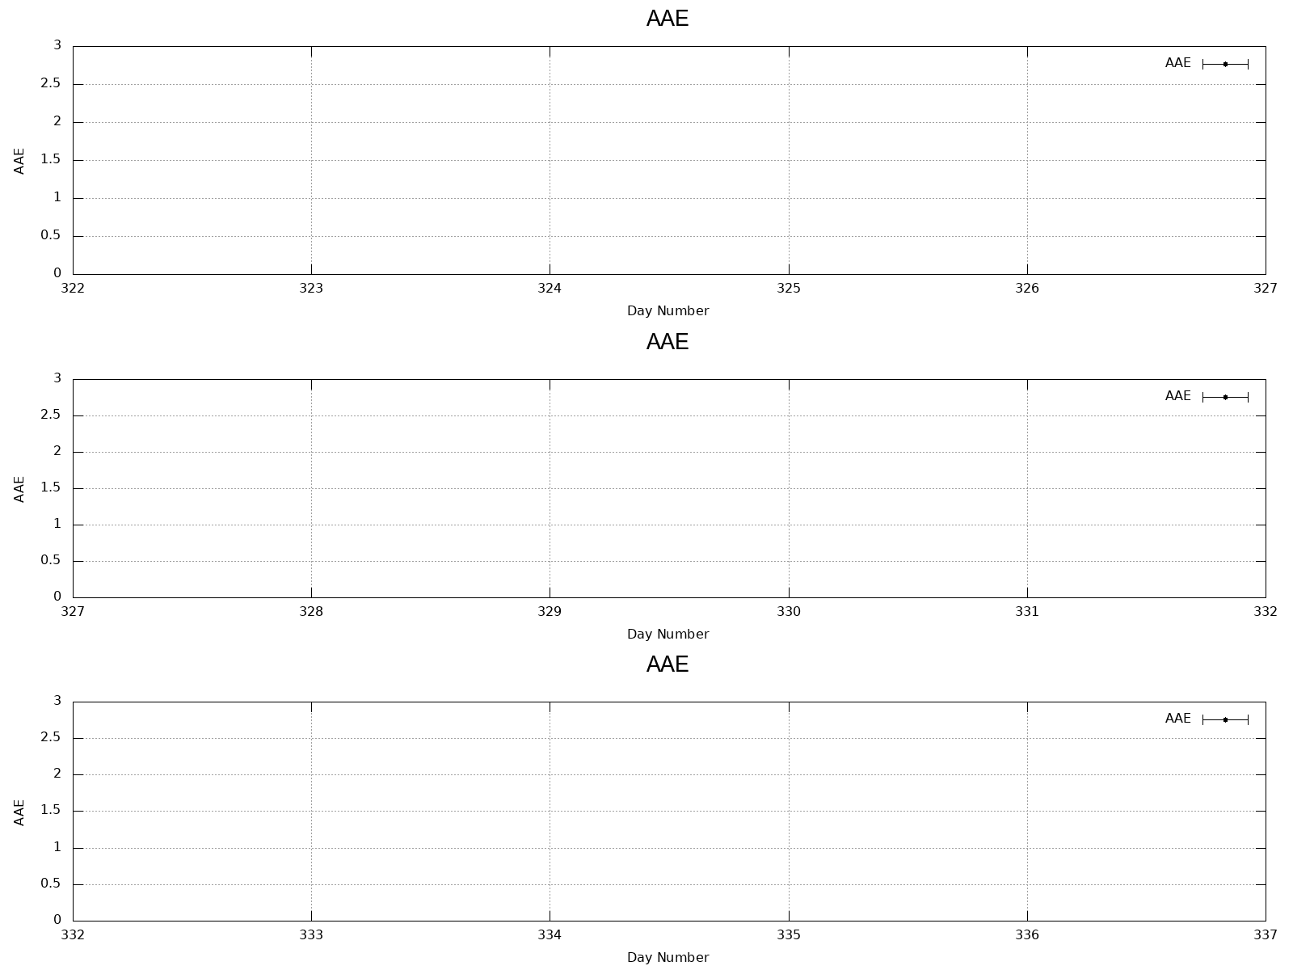
AAE (340~870 nm)

Slide 8
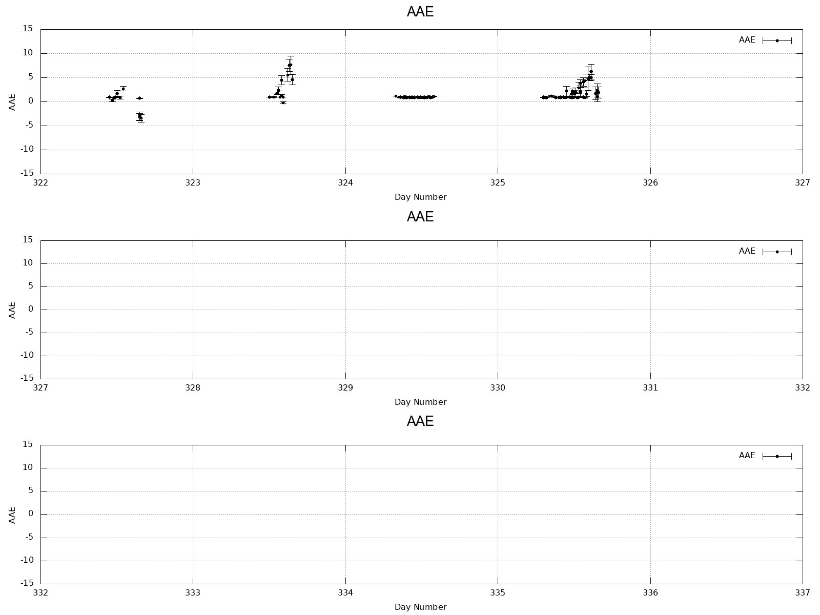
AAE (340~870 nm)雲データ除外の条件のみ

Slide 9
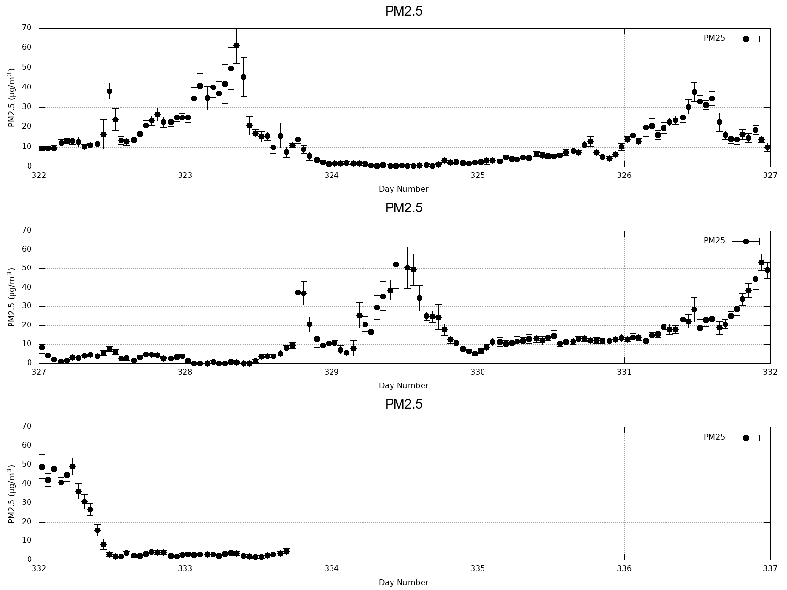
PM2.5 (1h)

Slide 10
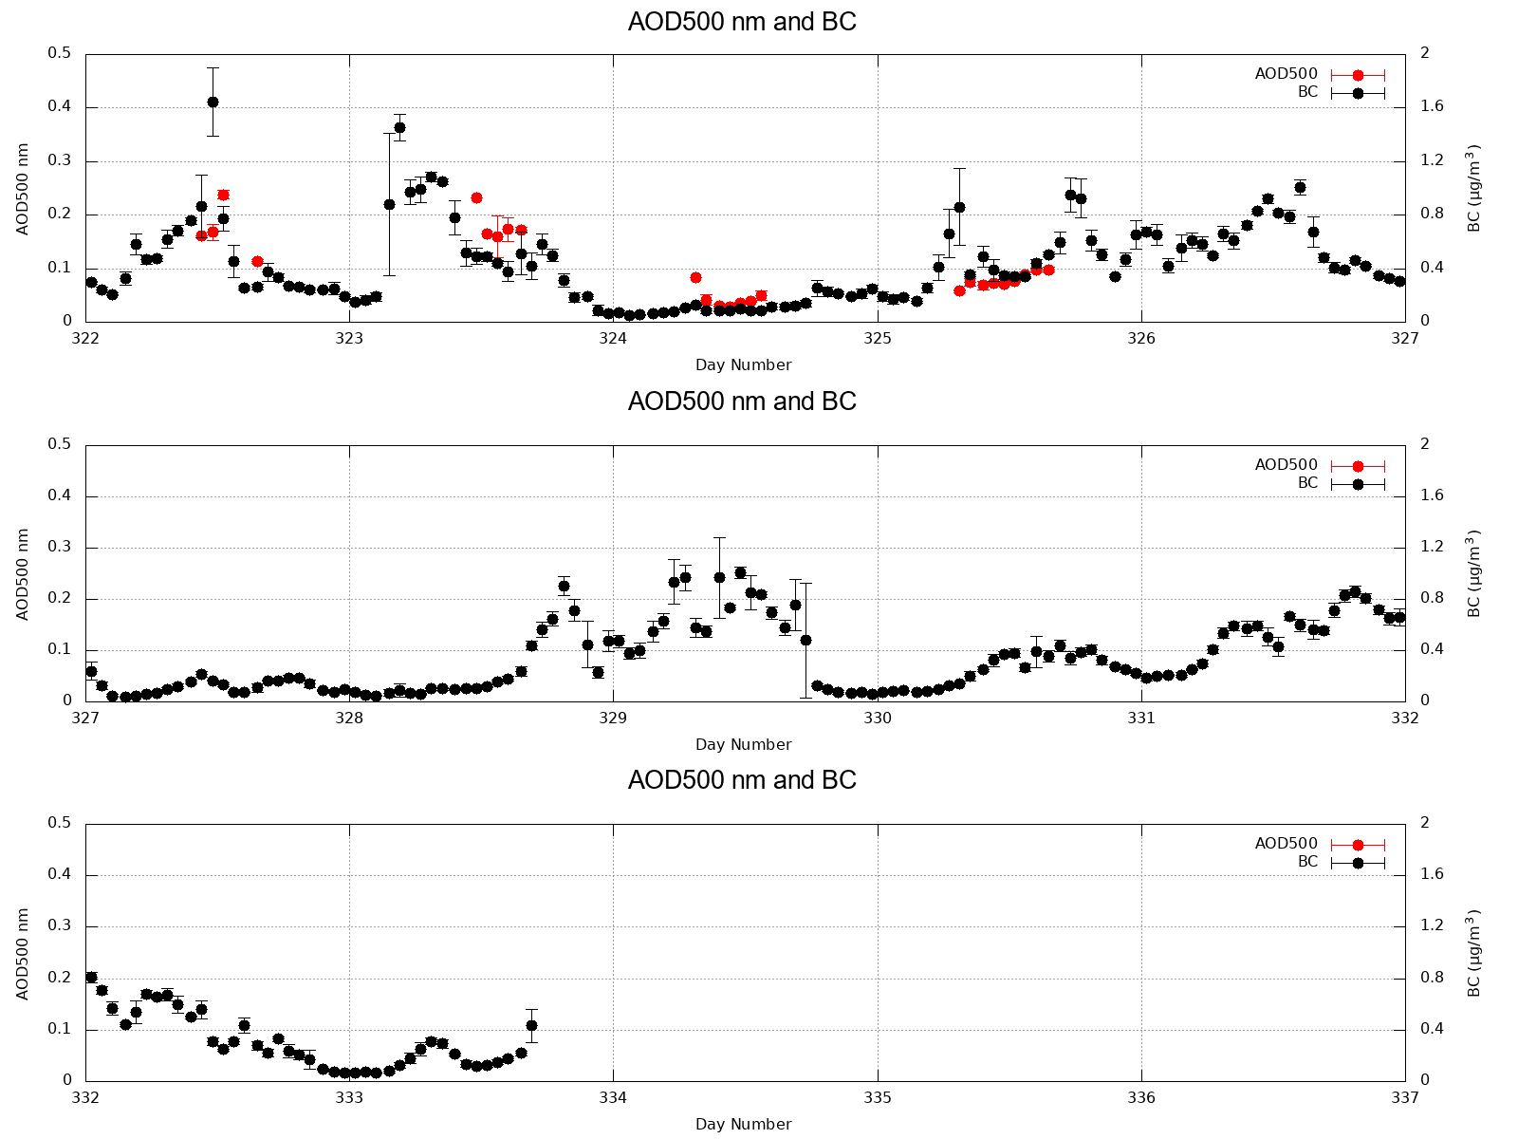
AOD(500 nm) and BC (1h)

Slide 11
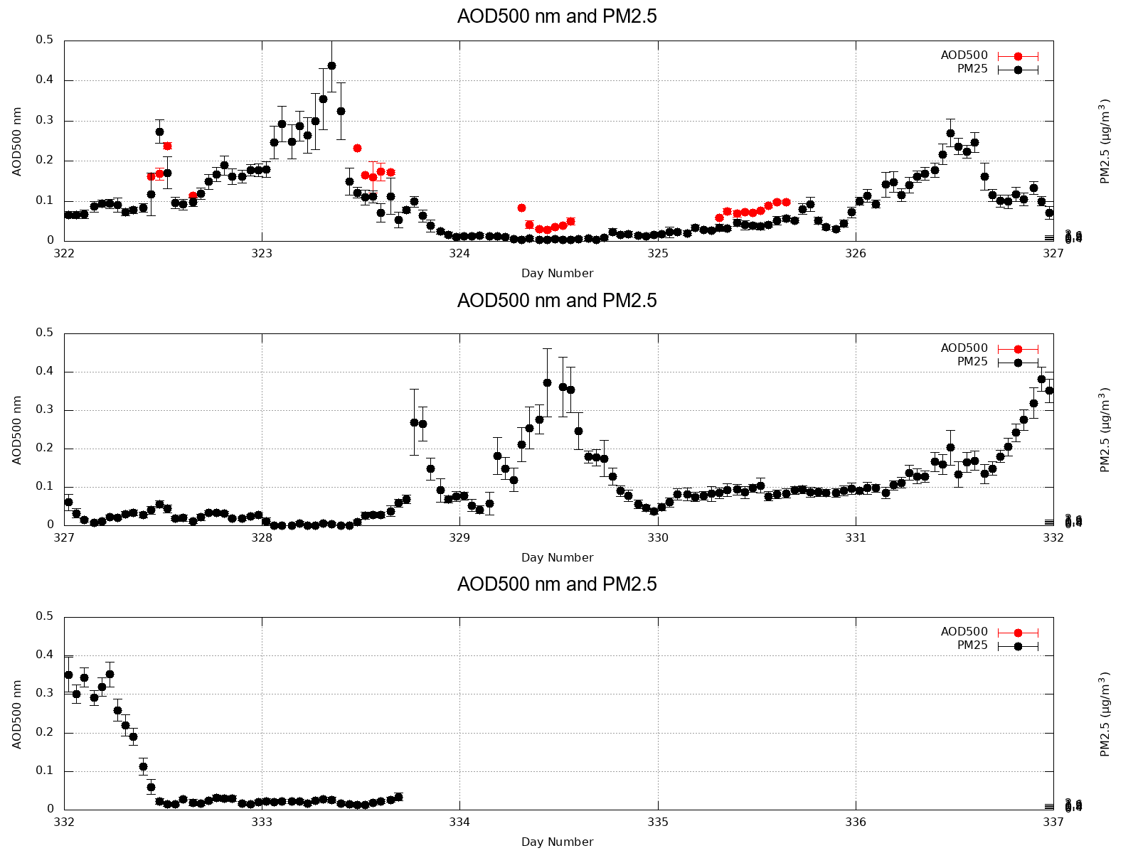
AOD(500 nm) and PM2.5 (1h)

Slide 12
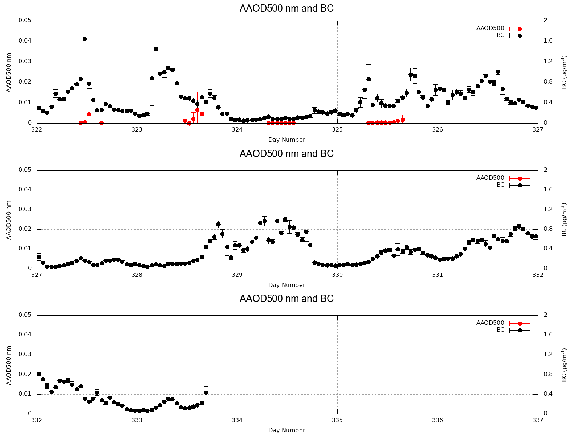
AAOD(500 nm) and BC (1h)

Slide 13
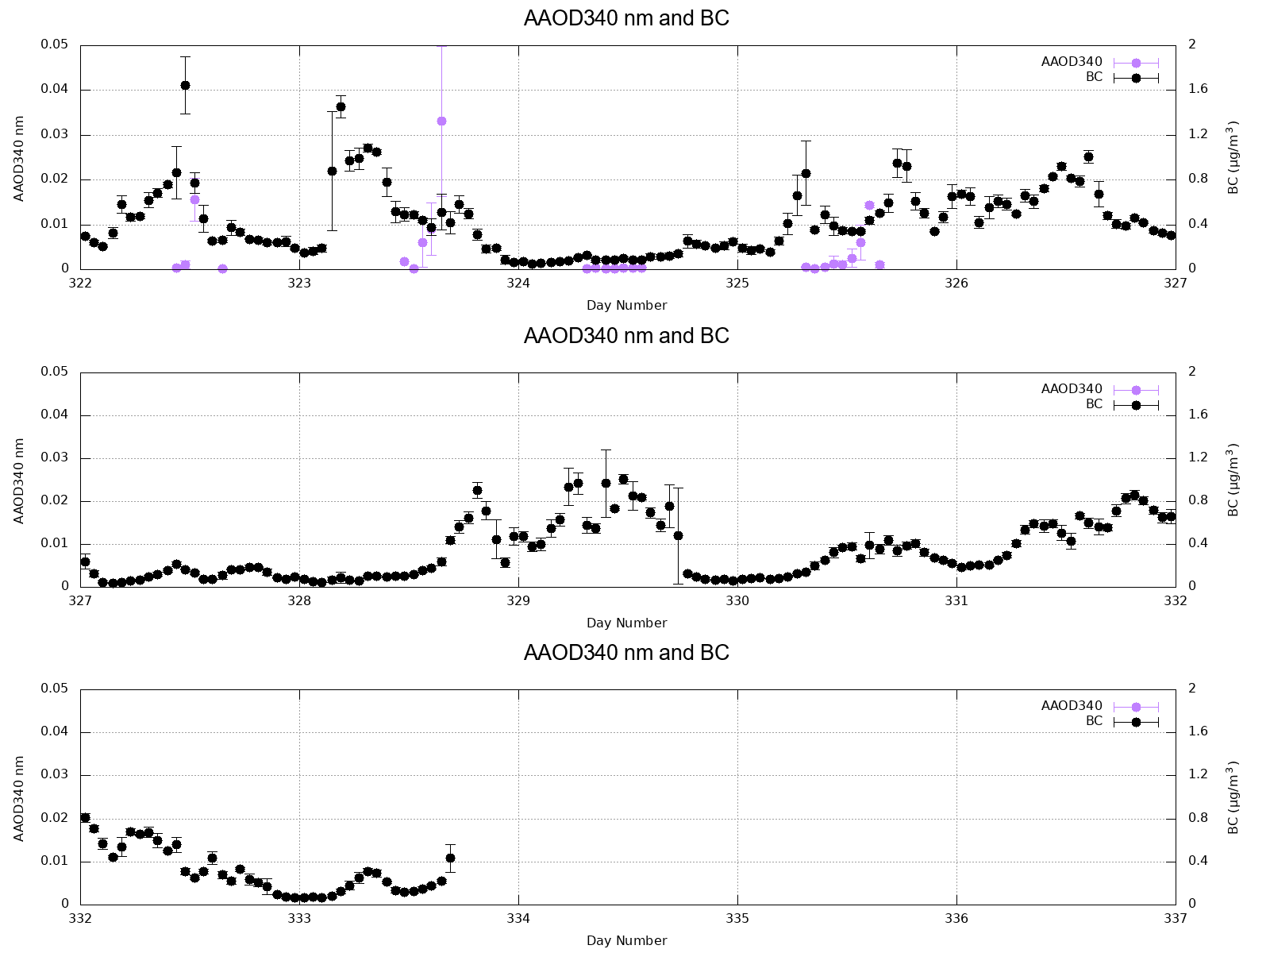
AAOD(340 nm) and BC (1h)

Slide 14
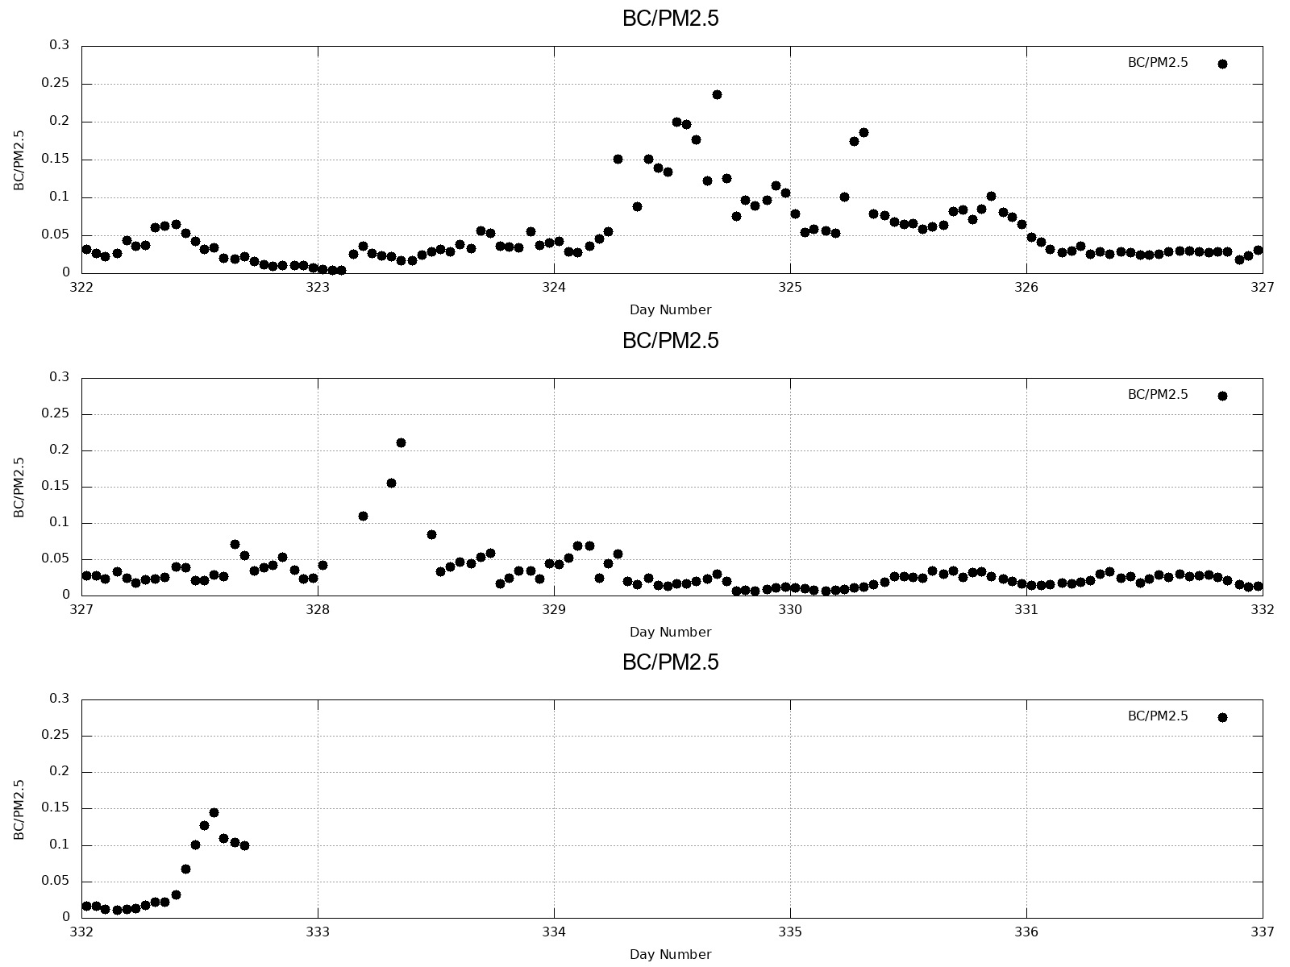
BC/PM2.5 (1h)

Slide 15
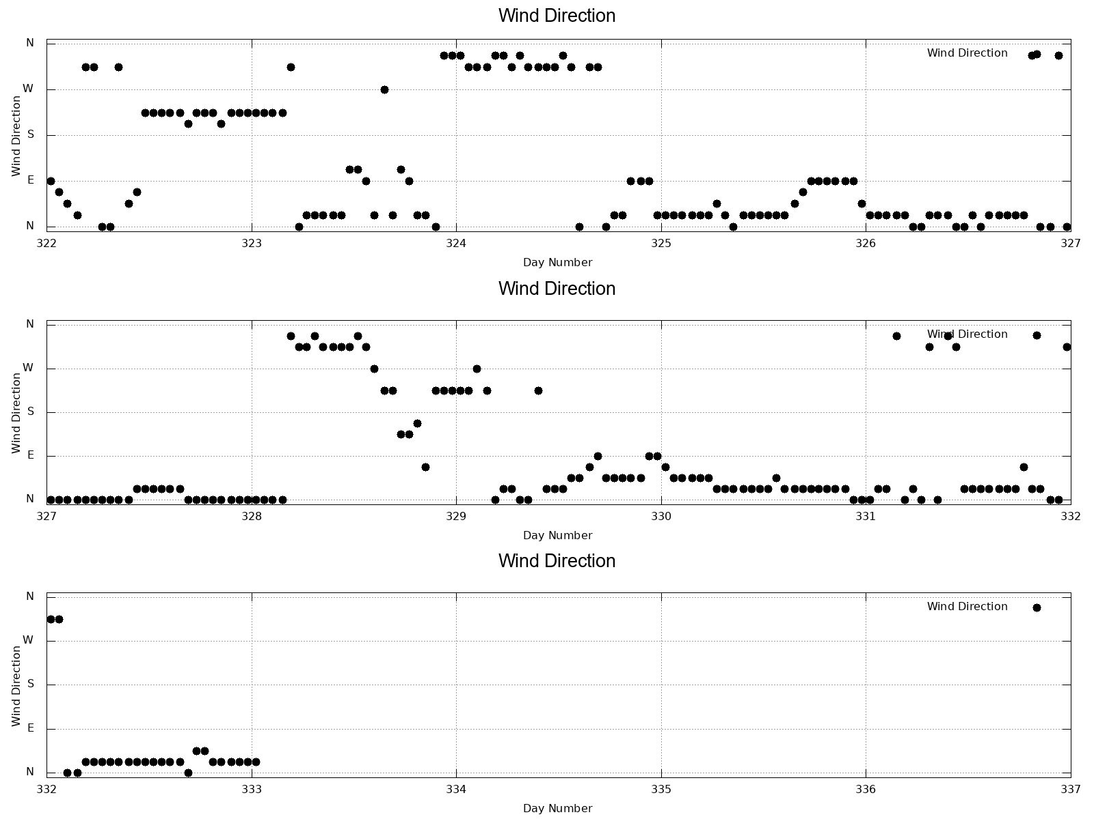
Wind Direction (1h)

Slide 16
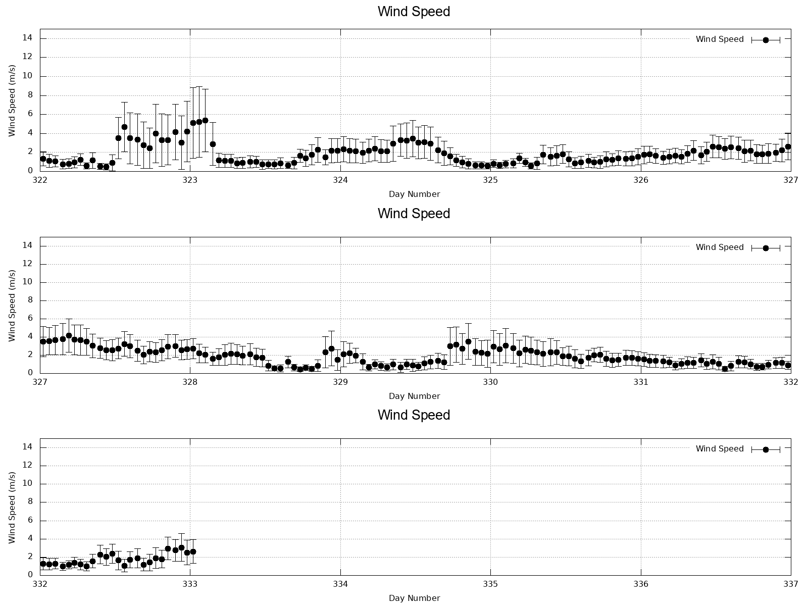
Wind Speed (1h)

